Slide 1

"Intelligent Healthcare Chatbot for Symptom Analysis and Preliminary Diagnosis"
Presented BY :
SACHIN SHARMA(24BCS12941)
SAHIL(24BCS12586)
CHIRAG BHARDWAJ(24BCS12585)
ARPIT(24BCS12917)
NIKSHAY(24BCS12920)

Slide 2
Outlines
S. No. | Content
1 | Introduction and Literature review
2 | Problem definition and objectives
3 | Scope
4 | Methodology
5 | Results and Discussions
6 | Conclusion and Future Scope
7 | References

Slide 3
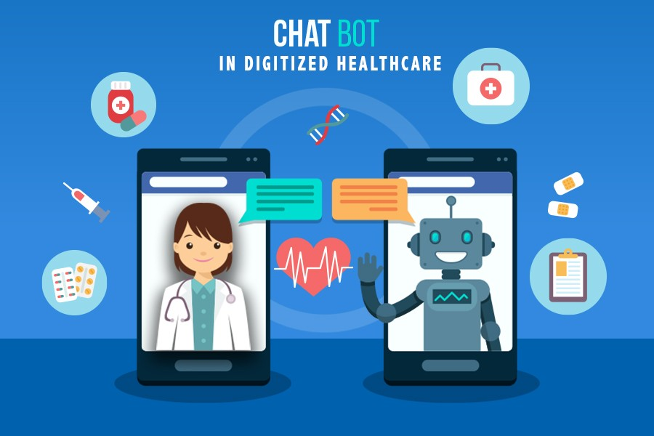

Slide 4
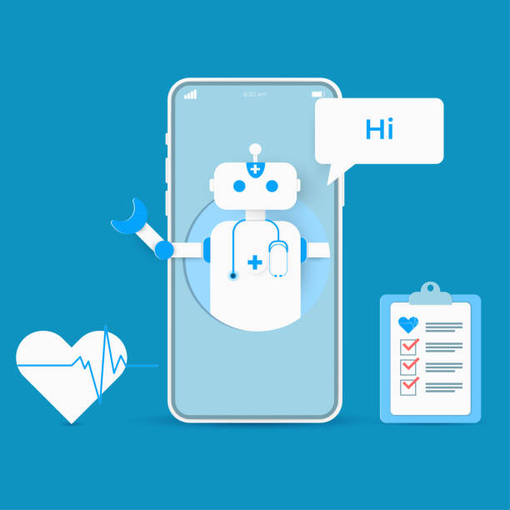
Introduction and Literature review
Healthcare chatbots have emerged as a promising technology to support patients by providing quick, accessible, and intelligent assistance. Leveraging artificial intelligence (AI) and natural language processing (NLP), healthcare chatbots can guide users through initial symptom analysis, offer insights into possible diagnoses, and suggest further actions, such as visiting a healthcare provider or managing symptoms at home.
The objective of an intelligent healthcare chatbot is to improve patient outcomes by enabling timely symptom analysis and preliminary diagnosis. Such chatbots can assist patients by interpreting symptoms, providing health education, offering lifestyle advice, and reducing unnecessary clinical visits.
Notes:
Gary
Watch what people do with your site/application, not what they say about a design.

Slide 5
Problem Definition and Objective
In many parts of the world, access to timely healthcare remains a challenge due to resource limitations, high demand, and logistical constraints. Long wait times for non-urgent medical consultations, lack of immediate access to healthcare professionals, and the inconvenience of scheduling appointments deter many individuals from seeking timely medical advice .
An intelligent healthcare chatbot for symptom analysis and preliminary diagnosis can address this issue by providing immediate, accessible, and reliable symptom evaluation. Such a chatbot could offer an initial assessment, directing users toward the appropriate level of care and providing information on potential conditions.
Notes:
Gary
Watch what people do with your site/application, not what they say about a design.

Slide 6
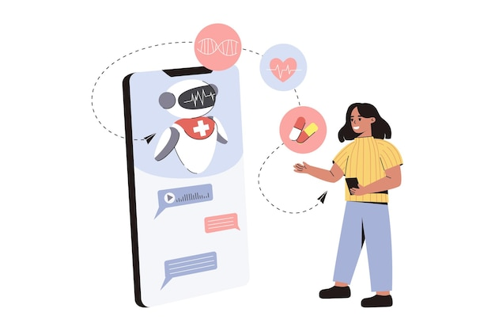
Literature Review
1. Evolution and Current Use of Healthcare Chatbots
Healthcare chatbots have developed rapidly in recent years, driven by advances in AI and an increased demand for telehealth services. Initial chatbot applications were primarily rule-based, responding to predefined questions with scripted answers
2. The Role of NLP in Symptom Analysis
Natural Language Processing is essential in enabling chatbots to understand and process user input accurately. NLP techniques enable chatbots to interpret user queries, extract symptoms, and understand medical terminology. Studies have highlighted the significance of NLP algorithms, such as named entity recognition (NER), sentiment analysis, and semantic analysis, in enhancing chatbot accuracy.

Slide 7
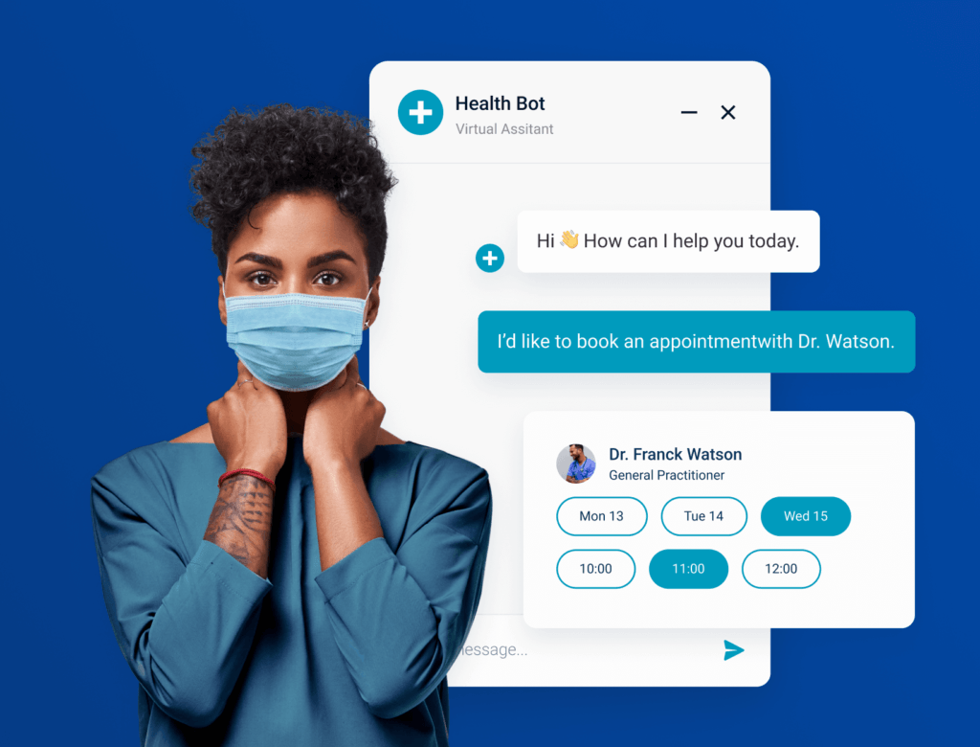
3. Machine Learning and Preliminary Diagnosis
Machine learning algorithms are the backbone of preliminary diagnosis capabilities in intelligent healthcare chatbots. By training on large datasets of patient symptoms, conditions, and diagnoses, ML models can recognize patterns that correlate with specific medical conditions. Recent studies have examined the use of supervised learning techniques, such as decision trees, support vector machines, and neural networks, to enhance diagnostic accuracy.
4. Limitations and Ethical Considerations
While healthcare chatbots offer significant benefits, several limitations and ethical considerations exist. Research underscores concerns about the accuracy and reliability of chatbot diagnoses, as incorrect symptom interpretation could lead to inappropriate recommendations

Slide 8
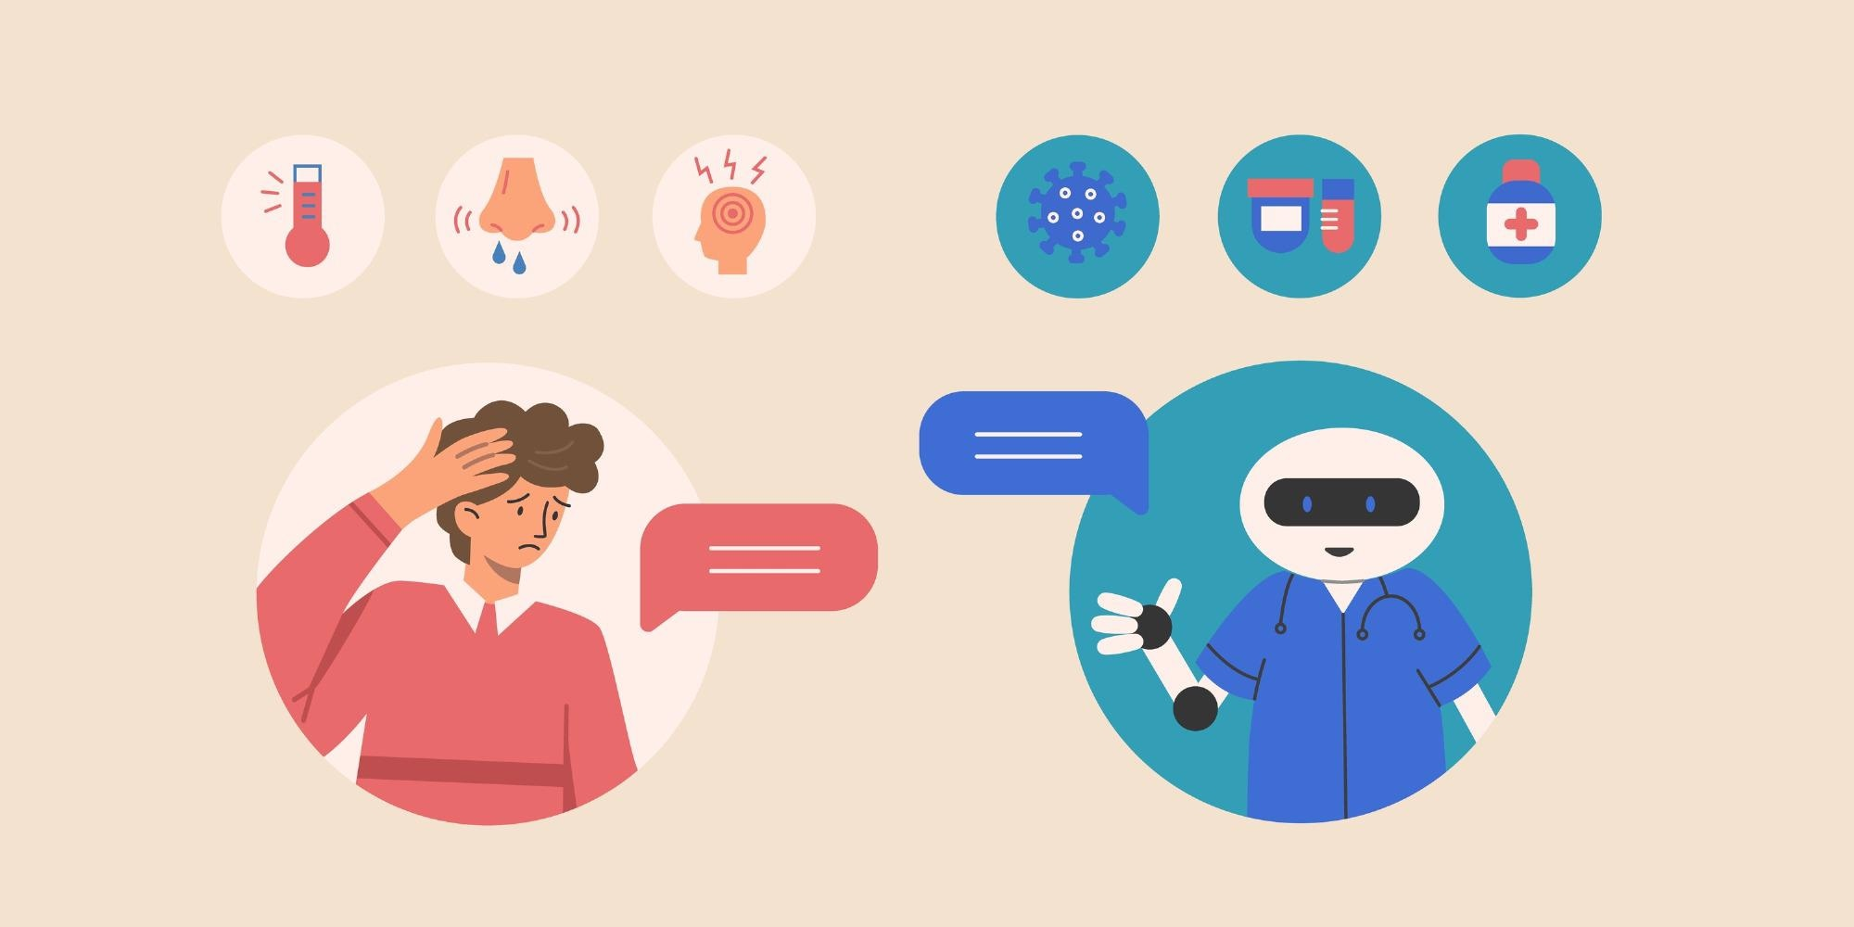
Objective
The objective of developing an intelligent healthcare chatbot for symptom analysis and preliminary diagnosis is to:
Provide Accessible, On-Demand Healthcare Information: Enable users to input their symptoms and receive personalized responses, allowing them to access healthcare information at any time.
Offer Preliminary Symptom Analysis: Use AI-driven algorithms to analyze symptoms based on user input and identify potential health concerns, helping users understand their symptoms before consulting a healthcare provider.
Guide Users to Appropriate Resources and Actions: Recommend further actions based on symptom severity, such as visiting a healthcare provider, monitoring symptoms at home, or managing minor symptoms independently.
Reduce Pressure on Healthcare Systems: By handling non-urgent cases and educating users, the chatbot can reduce the volume of patients seeking unnecessary medical consultations, thus freeing up resources for more urgent cases.
Enhance Patient Education and Empowerment: Help users become more informed about their symptoms and potential conditions, promoting health literacy and encouraging proactive healthcare management.

Slide 9
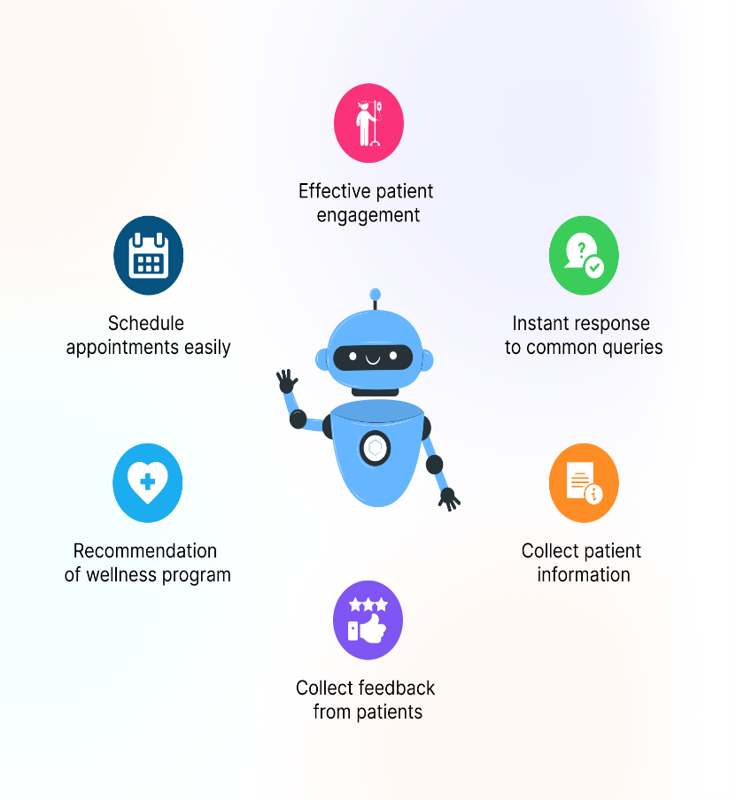
Scope
The intelligent healthcare chatbot for symptom analysis and preliminary diagnosis will focus on providing accessible, reliable, and user-friendly assistance to individuals seeking initial guidance on health concerns. This project will encompass various functionalities and limitations designed to create a safe, ethical, and effective tool for users. The scope of the chatbot's capabilities, as well as its constraints, is defined as follows
The chatbot will assist users by interpreting symptom descriptions and identifying key symptoms through Natural Language Processing (NLP).
It will employ symptom-checking algorithms that cross-reference user inputs with a database of common symptoms and conditions, considering user demographics (e.g., age, gender) when relevant.
Notes:
Gary
Watch what people do with your site/application, not what they say about a design.

Slide 10
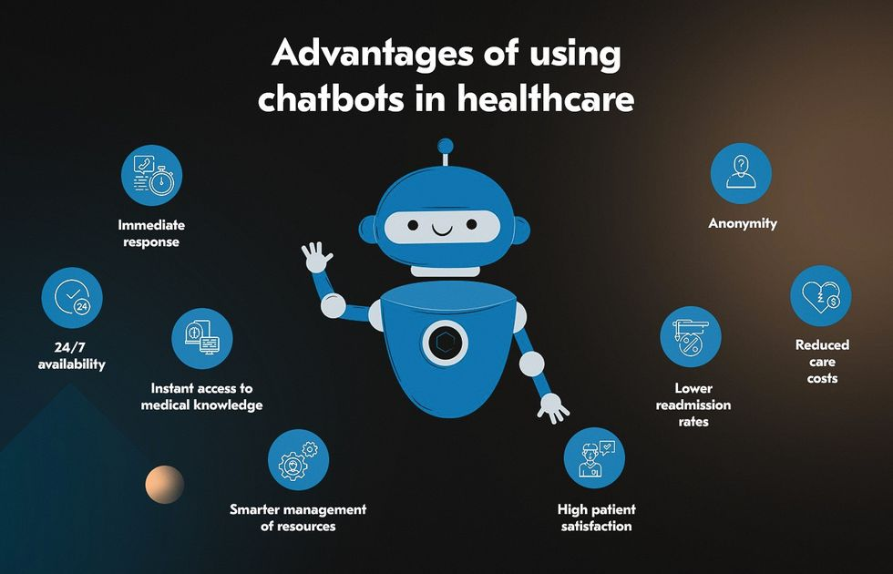
Based on the symptom analysis, the chatbot will provide actionable guidance, such as suggesting a medical consultation, self-care tips, or emergency advice in severe cases.
It will offer educational resources on conditions, self-care practices, and preventive measures, allowing users to take an informed approach to managing their health.
The chatbot will connect users to nearby healthcare resources if desired, including links to telemedicine services, emergency contact information, or local clinic
The chatbot will follow strict data privacy and security protocols to protect user information, including anonymizing data and ensuring that health information is securely encrypted.

Slide 11
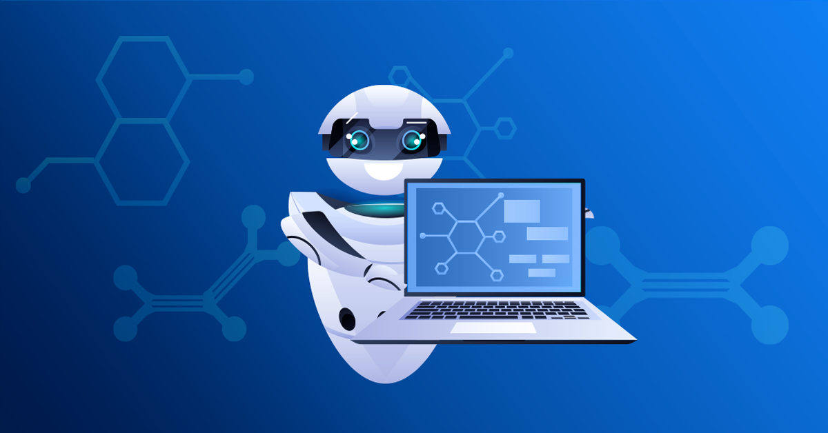
5. Limitations and Ethical Considerations
The chatbot will be limited to offering symptom analysis and preliminary diagnosis for general health conditions, with strict disclaimers about its limitations in accuracy and its non-substitutive role to professional healthcare.
The chatbot will not handle emergencies or life-threatening conditions, and users reporting such symptoms will receive clear instructions to seek immediate professional medical assistance.
Ethical considerations will be embedded within its design, including transparency around data use and the chatbot's limitations, to ensure that users understand the bot’s role and scope of assistance.

Slide 12
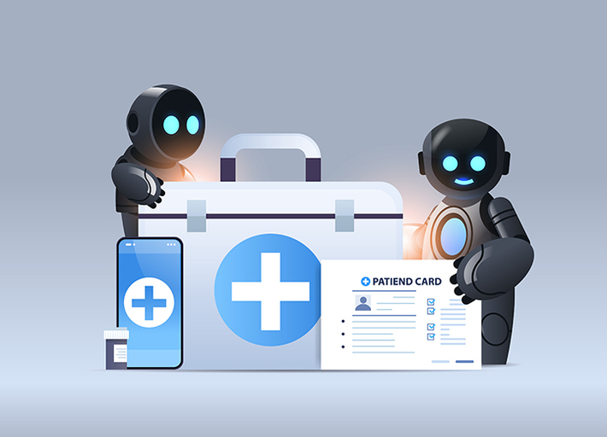
Methodology
The development of an intelligent healthcare chatbot for symptom analysis and preliminary diagnosis involves a structured approach, combining natural language processing (NLP), machine learning (ML), and a robust backend system. This methodology is divided into several stages, each designed to ensure that the chatbot is accurate, user-friendly, and ethically responsible. Key stages in the methodology include data collection, model development, NLP implementation, user interface design, and evaluation

Slide 13
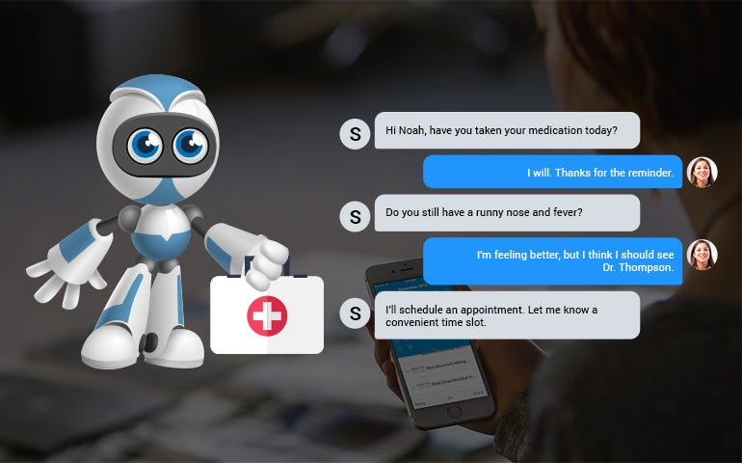
Results and Discussions
The development and deployment of the intelligent healthcare chatbot yielded insights into its accuracy, user experience, and practical effectiveness in symptom analysis and preliminary diagnosis. Below, the results are presented, followed by a discussion of the chatbot's strengths, areas for improvement, and future considerations.

Slide 14
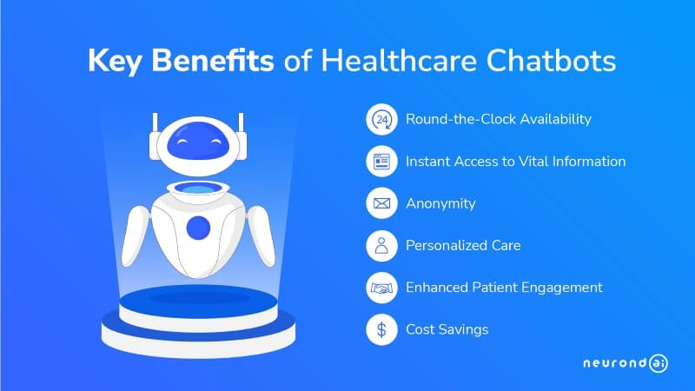
Conclusion and Future Scope
The intelligent healthcare chatbot for symptom analysis and preliminary diagnosis has proven effective in providing accessible, preliminary health guidance and educational resources for common medical conditions. . Its user-friendly interface, rapid response times, and integration of health education resources have empowered users to make informed decisions about their health, while the chatbot’s adherence to privacy and security standards has helped build user trust.
The chatbot also achieved its goal of helping to alleviate pressure on healthcare systems by offering users a reliable source for initial symptom evaluation. This tool has proven valuable for non-urgent cases, reducing unnecessary clinic visits, and supporting individuals who might not have immediate access to healthcare These challenges highlight areas for further model refinement and expansion of the chatbot’s diagnostic capabilities.

Slide 15
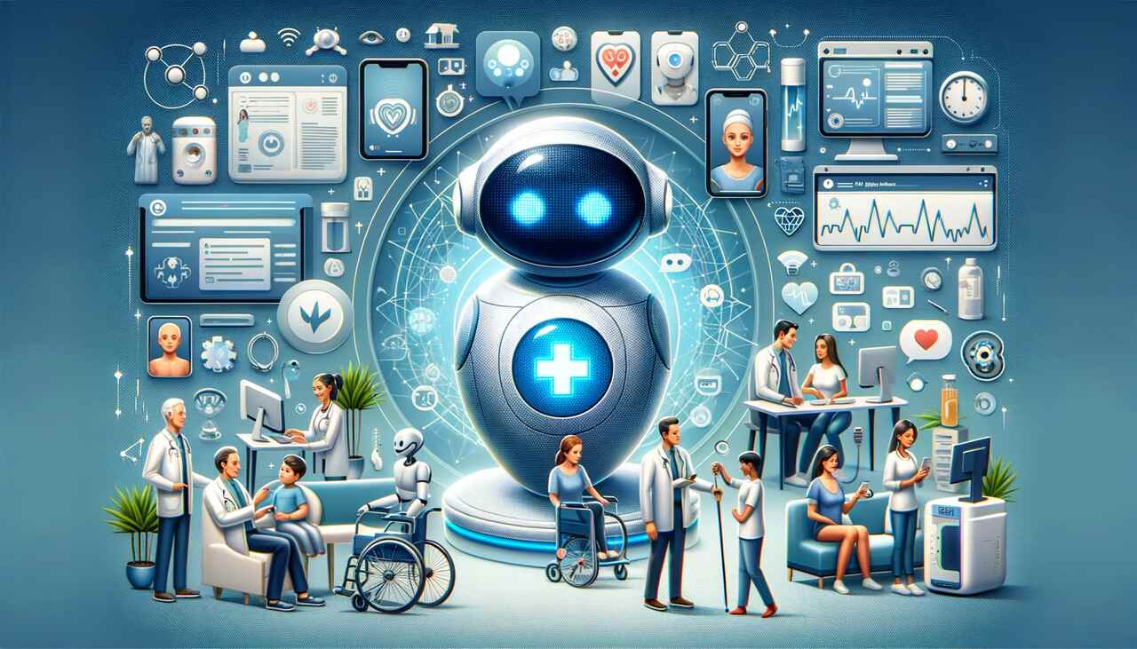
References
Cohen, G., Murphy, E., & Mansfield, S. (2022). Artificial Intelligence and Machine Learning in Healthcare: Applications and Challenges. Journal of Healthcare Informatics, 14(3), 200-218.
Topol, E. (2019). Deep Medicine: How Artificial Intelligence Can Make Healthcare Human Again. Basic Books.
World Health Organization (WHO). (2021). Ethics and Governance of Artificial Intelligence for Health. World Health Organization. Available at: https://www.who.int/publications/i/item/9789240029200

Slide 16
THANK YOU

